Slide 1
Realtime Databases and Authentications

Slide 2
Objectives
Understand and use Realtime databases
Connect to Firebase database
Push and download data
Enable Firebase Auth and use database rules

Slide 3



Slide 4
With SQL database and on a Server:
Need to build Web Service, design Relational Schema and worry about concurrency and security
this one is phpmyadmin which acts as ui for mysql for php

Slide 5

What is Firebase?
What is Firebase?
BaaS ( Backend-as-a-Service ), which powers the backend of the App / Website
Main Features
Drive: Small businesses, Shorten development cycles, avoid repeated framework development.

Slide 6
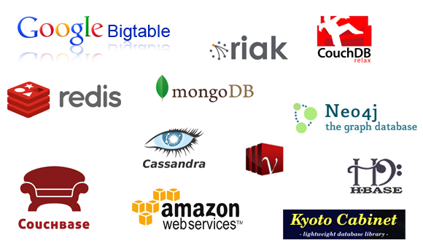
What is NoSQL?
What is NoSQL?
not only SQL database.
Non-relational, distributed, open-source, and horizontally scalable.
Drive: Big Data, Cloud Technology, bad performance of traditional relational databases.

Slide 7
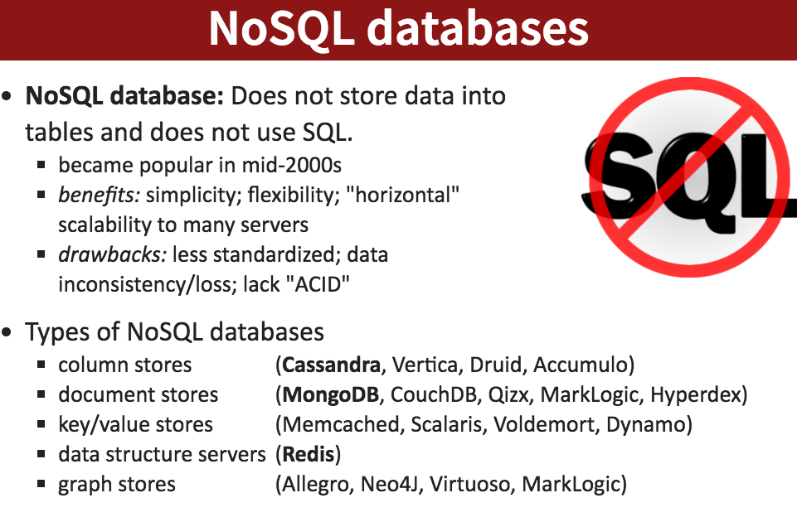

Slide 8

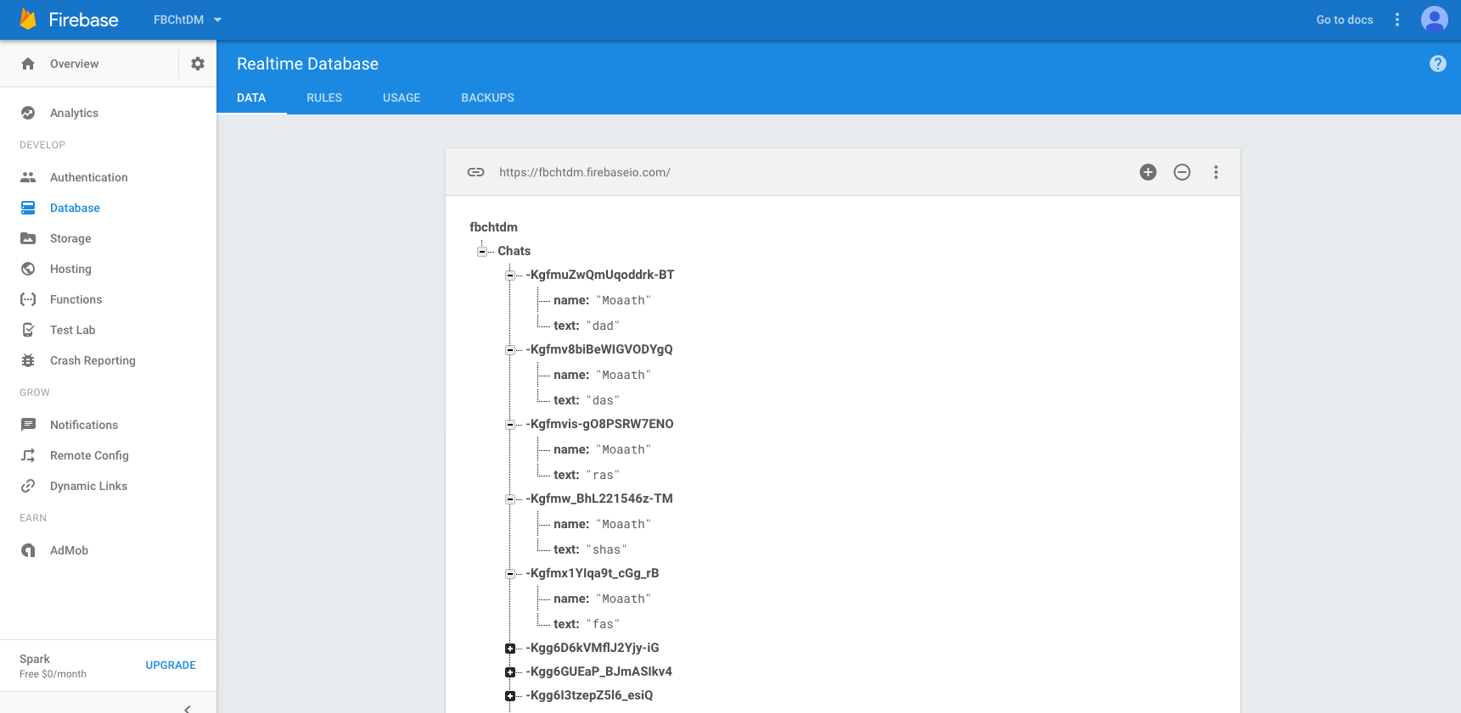

Slide 9
DIY setup Firebase
Gradle link to the current version of Firebase DB
https://firebase.google.com/docs/android/setup
How Firebase Store Data
The database is a giant nested map of string keys to values.
text, numbers, boolean, lists, or maps
object: {"key" => value} map
list: {index => value} map
overall database is tree-like map structure you can view on the web
Install Firebase into Android Studio project
option 1: use UI: Tools → FireBase → Realtime Database → ...
option 2: do it yourself (Gradle as above)

Slide 10
Writing Firebase data
// create a key/value pairing
val fb = FirebaseDatabase.getInstance().getReference();
fb.child("name").setValue(value);
Firebase stores data as key/value pairs
the keys are strings representing data object names
the values can be one of many types:
Boolean, Long, Double, List, Map<String, Object>
think of Firebase as a HashMap on steroids in the cloud

Slide 11
DatabaseReference methods
Method Description
dbr.child("name") return child object with given name (creates if missing)
dbr.getKey() return key for a given data value
dbr.getParent() return data one level up in the map
dbr.getRoot() return data at top of map
dbr.push() create/return an auto-created new child
dbr.removeValue();
dbr.removeValue(handler); delete value associated with this key
dbr.runTransaction(handler); run multiple queries in sequence
dbr.setPriority(priority); gives this data a 'priority' rating for sorting
dbr.setValue(value);
dbr.setValue(value, handler);
dbr.setValue(value, priority, handler);
sets new data value, with optional listener to be notified when sync
is complete
dbr.updateChildren(map);
dbr.updateChildren(map, handler);
updates some of object's fields ("children") using the key/value data in the
given map

Slide 12
SetValue with callback
When you call setValue, the data may not update immediately on the server.
Your data might be distributed across many servers; it takes time to sync them.
To be notified when the data is fully written:
val database = Firebase.database
val myRef = database.getReference("message")
myRef.setValue("Hello, World!")

Slide 13
Auto-generated keys
Some tables don't have an "id" column.
Firebase can make up IDs with push().
Also useful in highly parallel situations where many users modify the data at once.
DatabaseReference fb = ...;
val chat= fb.child(”Msgs/chat");
val newChat = chat.push();
newChat .child(”msg_id").setValue(123);
newChat .child(”name_id").setValue(10001);
newChat .child(”other").setValue(”XX");

Slide 14
Retrieving data
Getting data is more complex than setting it.
Must grab the Firebase object for that data, and bind an event handler to it.
Will be notified initially and on state changes.
// Read from the database
myRef.addValueEventListener(object: ValueEventListener() {
override fun onDataChange(snapshot: DataSnapshot) {
// This method is called once with the initial value and again
// whenever data at this location is updated.
val value = snapshot.getValue<String>()
Log.d(TAG, "Value is: " + value)
}
override fun onCancelled(error: DatabaseError) {
Log.w(TAG, "Failed to read value.", error.toException())
}
})

Slide 15
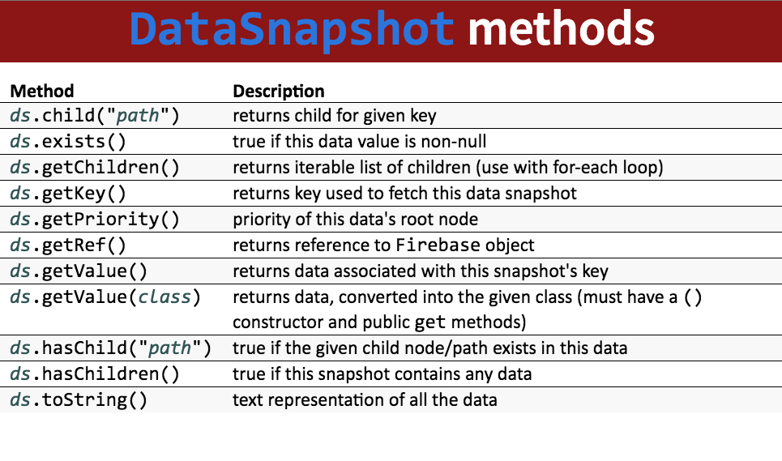

Slide 16
Querying data
More info:
https://firebase.google.com/docs/database/android/read-and-write?utm_source=studio

Slide 17
Security and authentication
There are several ways to allow/deny access to your database
Firebase-specific accounts; Google accounts; etc.
Use Firebase web UI to add email/password user accounts
Modify code to sign in with email and password:
private FirebaseAuth mAuth;
mAuth = FirebaseAuth.getInstance();
mAuth.signInWithEmailAndPassword("username", "password");
// optional: addOnCompleteListener, addAuthStateListener

Slide 18
FirebaseAuth methods
Method Description
createUserWithEmailAndPassword("email", "pw") create new account
signInWithEmailAndPassword("email", "pw") log in a standard user
signInWithCredential(auth) log in using access creds
signInAnonymously() log in as anon. user
signInWithCustomToken("token") log in with an auth token
signOut() disconnect
getCurrentUser() return active user account

Slide 19
Firebase Rules
Firebase allows three main rule types: .read, .write. And .validate.
Each of these can be set to “true” or “false” and can apply to the whole database or a particular location in the database depending on how they are configured.
Rule Type Description
.read Describes whether data can be read by the user.
.write Describes whether data can be written by the user.
.validate Defines what a correctly formatted value looks like, whether it has child nodes, and the data type.

Slide 20
Rule Types
Predefined Variables
Firebase Database Security includes a set of predefined variables that enable you to customize data accessibility. Below is a list of predefined variables and a link to each API reference.
Variable Description
now The current time in milliseconds since Unix epoch time (January 1, 1970)
root Corresponds to the current data at the root of the database. You can use this to read any data in your database in your rule expressions.
newData Corresponds to the data that will result if the write is allowed
data Corresponds to the current data in Firebase Realtime Database at the location of the currently executing rule.
$variables A wildcard path used to represent ids and dynamic child keys.
auth Contains the token payload if a user is authenticated, or null if the user isn't authenticated.
We will expand on the auth variable because we will use it in database security examples.

Slide 21
Auth
The auth variable contains the JSON web token for the user. A JSON Web Token is a standard that defines a way of securely transmitting information between parties, like the database and a client, as a JSON object. Once a user is authenticated, this token contains the provider, the uid, and the Firebase Auth ID token.
The provider is the method of authentication, such as email/password, Google Sign In, or Facebook Login.
The uid is a unique user ID. This ID is guaranteed to be unique across all providers, so a user that authenticates with Google and a user that authenticates with email/password do not risk having the same identification.
The Firebase Auth ID is a web token. Yes, this means that there is a web token inside of the Auth web token! This token can contain data such as email, password, name and so on.

Slide 22
End of Slides
Make sure to watch the lecture videos

